Slide 1
VIRAL HEPATITIS

Slide 2
Learning objective
Recognizing features of viral hepatitis in children
Be familiar with the important diagnostic test required to diagnose viral hepatitis ( mainly Hepatitis A)
Understand the preventive measures of viral hepatitis in community including vaccination

Slide 3
Introduction
Viral hepatitis caused by at least 5 pathogenic hepatotropic viruses recognized to date: hepatitis A, B, C, D, and E viruses
The hepatotropic viruses cause similar acute clinical illness.
Other viruses can cause hepatitis (HSV), (CMV), (EBV), varicella-zoster virus, HIV, rubella, adenoviruses, enteroviruses, parvovirus B19.

Slide 4
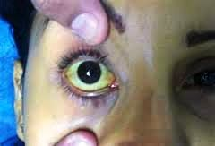
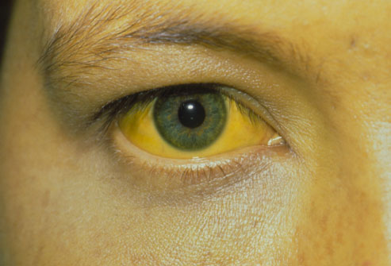
Issues Common to All Forms of Viral Hepatitis
Jaundice which is a mixed or direct reacting hyperbilirubinemia

Slide 5
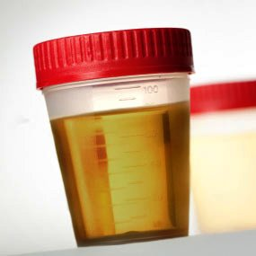
normal
Abnormal
Deep color urine
Clay color stool in
cholistatic phase

Slide 6
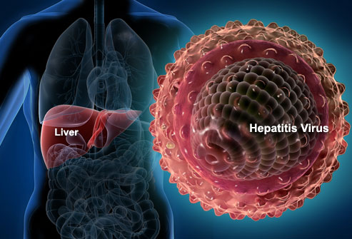
Enlarged and tender liver
Splenomegaly and lymphadenopathy may occure
Extrahepatic symptoms are more readily seen in HBV and HCV infections (rashes, arthritis).
Encephalopathy in ALF.

Slide 7
Common Biochemical Profiles in the Acute Hepatitis
Rise serum ALT and AST.
Cholestasis : elevated serum conjugated bilirubin , Elevation of ALP , 5′-nucleotidase, γ-glutamyl transpeptidase (GGT), and urobilinogen
Synthetic dysfunction is reflected by prolonged PT , high [INR], low serum albumin , metabolic disturbances (hypoglycemia, lactic acidosis, hyperammonemia), and encephalopathy

Slide 8
A 10-years-old male complaining from nausea, vomiting , poor appetite and fever for one week duration .he state that his urine color become dark and has frequent upper abdominal pain .his mother state that his eyes looks yellow since today .and his close friend in the school had the same complaint around 3 weeks ago .
On examination , he looks ill , mild dehydration , jaundiced , not anemic , BPr , PR , RR are normal . There is tender palpable liver 4cm below costal margin .
Q1 / What is the most likely diagnosis ?
Q2 / What important test would you recommend for him including confirmatory test about your diagnosis ?
Q3 / How would you manage this patient ?
Q4 / What important preventive measures should be considered ?

Slide 9
Answer :
Q1 / Hepatitis A virus infection
Q2 / CBC , Liver function test ALT, AST, bilirubin, ALP, 5′-nucleotidase, and GGT , serum electrolyte , blood urea and creatinin .
Confirmatory test includes Anti-HAV IgM^{+ve} , Blood PCR positive, Rarely, by identifying viral particles in stool
Treatment of hepatitis A infection
Supportive treatment consists of intravenous hydration, antipruritic , fat-soluble vitamins for the prolonged cholestasis.
And Serial monitoring for signs of ALF

Slide 10
Q4 / Preventive measures of hepatitis A infection :
The mode of transmission of HAV is feco-oral
Infected patients is contagious 2 wk before and 7 days after the onset of jaundice and should be excluded from school, child care, or work
Careful hand washing is necessary
In hospital settings, contact and standard precautions are recommended for 1 wk after onset of symptoms.

Slide 12
DIAGNOSTIC BLOOD TESTS in HAV
ACUTE INFECTION : Anti-HAV IgM^{+ve} , Blood PCR positive
PAST INFECTION (RECOVERED) : Anti-HAV IgG^{+ve}
VACCINE RESPONSE : Anti-HAV IgG^{+ve}
Complications of HAV infection
most patients achieve full recovery
ALF from HAV infection is a rare
HAV can progress to a prolonged cholestatic syndrome

Slide 13
Prognosis of HAV infection
Is excellent, no long-term sequel. The only feared complication is ALF.
Hepatitis A Vaccine
two inactivated HAV vaccines are approved for children >1 yr of age. They are administered intramuscularly in a 2-dose schedule, with the 2nd dose given 6-12 mo after the 1st dose.
Indication of HA vaccine :
Child >1y : Endemic area , out break
Chronic liver disease
Occupational risk of exposure
Patients with immune disorder
In the USA universal vaccination for all children >1 yr of age.

Slide 14
Hepatitis B

Slide 15
Hepatitis B :
The usual acute symptomatic episode is similar to that of HAV and HCV infections but may be more severe and is more likely to include involvement of skin and joints .
incubation period ranges from 45 to 160 days(mean 120 days)
Diagnosis of HBV
Assay of ( HBsAg, anti-HBc, anti-HBs
Another test is PCR

Slide 16
HBV Serology
HBsAg: + ve
IgM anti-HBc: + ve
Anti-HBs: - ve
HBsAg: + ve
Anti-HBc: + ve
IgM anti-HBc: - ve
Anti-HBs: - ve
Acute HBV infection
Chronic HBV infection

Slide 17
Risk factors for HBV infection in children and adolescents
Intravenous drugs
Blood OR blood products
Contaminated needls used by acupuncture or tattoos
Sexual contact
Institutional care
Intimate contact with carriers.
In children, the most important risk factor for HBV is perinatal exposure to an HBsAg positive mother.

Slide 18
Perinatal exposure to an HBsAg-positive mother
90% of these infants become chronically infected if untreated.
In most cases, transmission occurred at the time of delivery. Virus contained in amniotic fluid or in maternal feces or blood may be the source
Infants of HBsAg^{+ve} women should treated as
At Birth HBIG (1st 12hr) + vaccine at birth , 1 and 6 mo
HBIG dose: 0.5 mL for newborns of HBsAg positive mothers, and 0.0 6 mL/kg for all others when recommended

Slide 19
Outcome of HBV
In general, the outcome after acute HBV infection is favorable, despite a risk of ALF.
The risk of developing chronic infection brings the risks of liver cirrhosis and hepatocellular carcinoma to the forefront.
Complications of HBV infection includes :
Acute liver failure , coagulopathy, Encephalopathy, and cerebral edema, Membranous glomerulonephritis , Chronic hepatitis which can lead to cirrhosis, end-stage liver disease, and primary hepatocellular carcinoma

Slide 20
Gastrointestinal Diseases

Slide 21
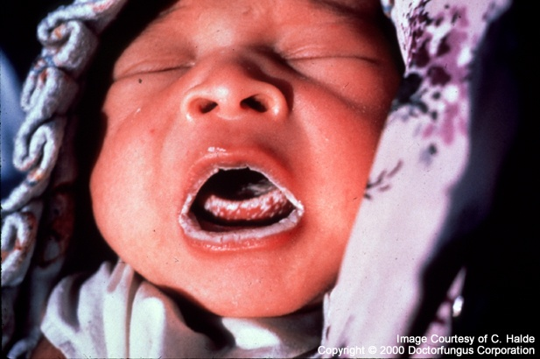
A neonate male patient presented with oral lesion , The lesion appears as a white plaques covering the oropharyngeal mucosa. These plaques when you removed, the underlying surface looks inflamed with pinpoint hemorrhages.
Q1 / What is the likely diagnosis ?
Q2 / What is the cause and how this neonate get this problem ?
Q3 / How you confirm the diagnosis ?
Q4 / How would you treat this patient ?

Slide 22
Answers :
Q1 / OROPHARYNGEAL CANDlDlASlS ( thrush )
Q2 / Oropharyngeal infection with Candida albicans
Mode of getting this disease in neonate :
Contact with the organism in the birth canal or breast.
Colonized breasts , hands, and/or improperly cleaned bottle nipples.
Kissing has also been implicated

Slide 23
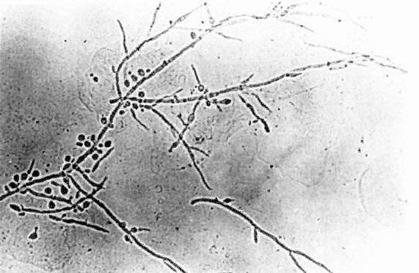
Q3 / diagnosis confirmed by :
Direct microscopic examination on potassium hydroxide smears preparation showed Pseudohyphae
Culture of scrapings from lesions.

Slide 24
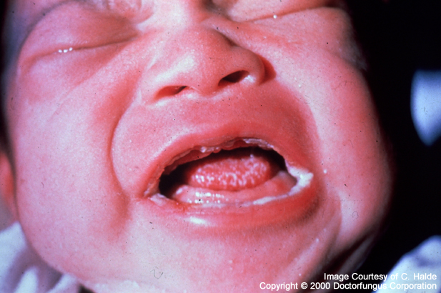
Q4 / Treatment :
Usually self-limited in the healthy newborn infant.
Treatment with nystatin will hasten recovery and reduce the risk of the infection spreading to other infants.
Persistent infections should be treated with fluconazole therapy.

Slide 25
Q / A-3-years-old male child complaining of sore throat and Fever , after few days he suffer from difficulty in eating and drinking, and a Peri-oral rash appeared with drooling of saliva . on examination : Gingiva is erythematous with small area of bleeding, multiple small vesicles seen in the mouth ,and there is tender palpable anterior cervical lymph nodes.
1/ What is the likely diagnosis?
2/ How would you treat this patient ?
3/ What precaution measures should be considered ?

Slide 26
Answer :
1/ Herpetic gingivostomatitis
2/
- Child rest.
- Encouraged Fluids intake
-Analgesics and anesthetic rinses
-Oral acyclovir is beneficial in shortening the duration of symptoms.
3/
-Caution, to prevent autoinoculation to the eyes.
-Avoid spreading the virus to others by hand washing with soap and hot water.
- Do not share food or drinks. Keep toys and utensils clean.

Slide 28
Q/ 15-year-old boy, previously well, presents with upper abdominal pain for the last month, which is dull in nature alleviated by the ingestion of food, and sometimes awaken the patient at night .the patient noticed that his stool is black and on examination he looks pale.
What is the likely diagnosis?
What important investigation should performed to reach for the diagnosis?
Give two complication of this condition

Slide 29
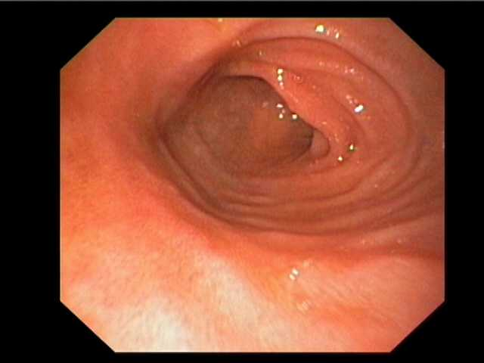
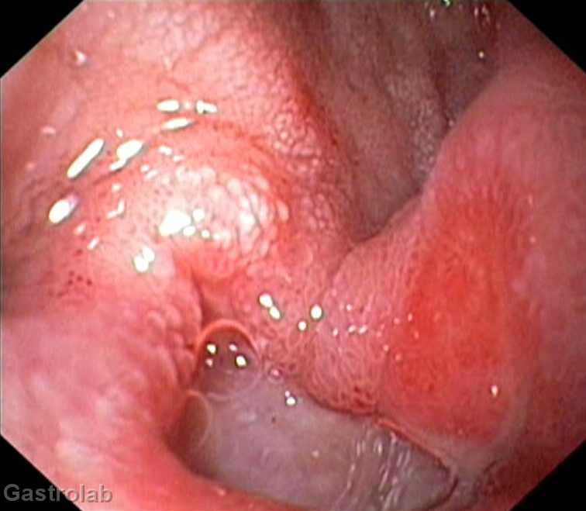
answer
Peptic ulcer disease
Esophageogastroduodenoscopy . and a Biopsy specimens must be obtained from the esophagus, stomach, and duodenum for histological assessment as well as to screen for the presence of H. pylori infection
Hemorrhage and perforation

Slide 30
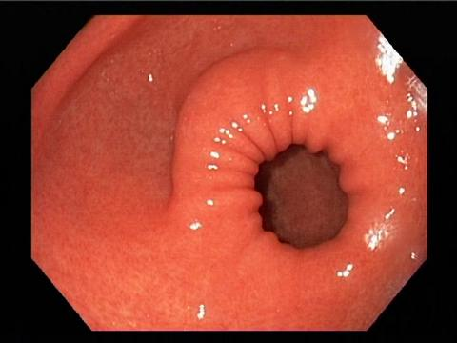

Slide 31
Helicobacter Pylori Infection
H. pylori is a gram-negative, S-shaped rod . H. pylori lies deep within the mucus layer which covers the gastric mucosa . it produces urease, catalase, and oxidase Through the action of the enzyme urease, which produces ammonia and the release of cytotoxins, the underlying mucosa becomes damaged and inflamed.

Slide 32
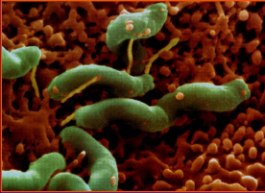

Slide 33
H.pylori may play a role in the pathogenesis of peptic ulcer disease.
All children infected with H. pylori develop histological picture of chronic active gastritis but the majority of children are a symptomatic.
Chronic colonization with H. pylori can predispose children to a significantly increased risk of developing a duodenal ulcer or gastric cancer such as adenocarcinoma. or MALT (mucosa-associated lymphoid tissue lymphomas)

Slide 34
Primary peptic ulcers
which are chronic and more often duodenal. most often associated with Helicobacter pylori infection , usual age >5years .
Secondary Peptic ulcer
usually more acute and more often gastric. Causes :
Stress. e.g: sepsis, shock, or intracranial lesion .
Severe burn injury (Curling ulcer).
Non steroidal anti-inflammatory drug
Hypersecretory states like Zollinger-Ellison syndrome

Slide 35
Clinical manifestation of peptic ulcer
Older children
localized epigastric discomfort,
nocturnal wakening
and relief of symptoms with food or antacids
Younger children
Non-specific symptoms :-
vague abdominal pain
vomiting and nausea
Some children may present with anemia , hematemesis or melena.

Slide 36
The diagnosis of H. pylori infection made by:
initial upper GI endoscopy. findings either grossly normal to nonspecific gastritis with prominent rugal folds , Nodularity or ulcers.
Histological by demonstrating the organism in the biopsy specimens. Biopsy specimens must be obtained from the esophagus, stomach, and duodenum for histological and screen for the presence of H. pylori
Serologic assays using validated immunoglobulin G (lgG) antibody detection may be helpful for screening for the presence of H. pylori
Stool antigen tests: Sensitivity is 95% and specificity is 90%
Rapid urease test
urea breath tests

Slide 38
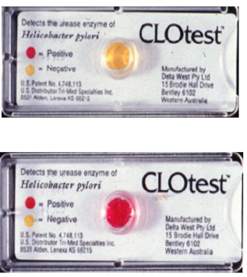
Rapid urease test

Slide 39
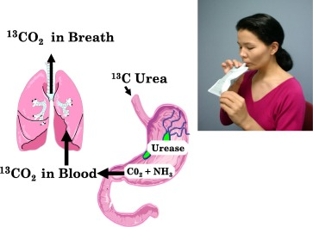

Slide 40
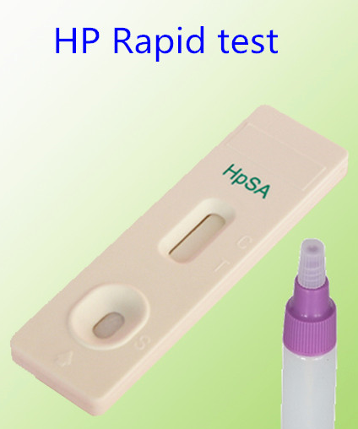
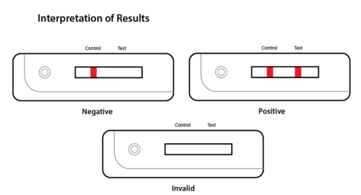

Slide 41
Treatment of H. pylori-associated ulcers:
- Omeperazole-clarithromycin- amoxicillin or
-Omeperazole- metronidazole - amoxicillin or
-Omeperazole -clarithromycin -metronidazole
The duration of antibiotic therapy is 2 wk and proton pump inhibitor for 1 month

Slide 42
A 3-year-old boy presents with a history of difficulty passing stools from 8 months old . His stooling was normal until solids were introduced at 6 months. the patient has had frequent abdominal pain and sometimes vomiting . The physical examination often demonstrates a large volume of stool palpated in the suprapubic area , and the rectum is enlarged, and stool is present just beyond the anal verge.
1/ What is the likely diagnosis ?
2/What initial investigation that might helpful for assessing this patient
3/ How would you treat him?

Slide 43
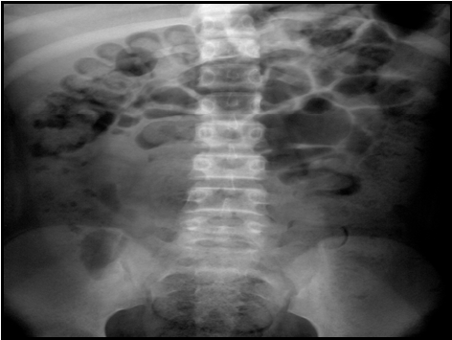
Answer :
1/ Functional constipation (idiopathic constipation)
2/ plain abdominal X-Ray

Slide 44
3/ treatment
a. Reassuring the parents that the situation will improve
b. Relief impaction if present by pediatric enema 1-2/day and Once the large intestine is empty, oral laxatives should be prescribed.
c. Softening of the stool as maintenance medications. until a regular bowel pattern has been established
d. Regular bowel training program
e. Drink plenty of fluid and to eat a good balanced diet containing fruit and vegetables

Slide 45
FUNCTIONAL CONSTIPATION (FC) / idiopathic constipation
Delay or difficulty in defecation that present for 2 wk or longer. Constipation typically starts after the neonatal period.
The child is usually otherwise well although abdominal pain and occasionally nausea and vomiting may be present .
A child with FC may have leakage of fecal liquid around the hard compacted stools in the dilated rectum causing soiling.

Slide 46
Rectal examination to exclude underlying anatomic abnormalities that might account for the constipation
Rectal examination : the rectum is generally enlarged, and stool is present just beyond the anal verge (dilated rectal vault filled with stool).
Following the digital examination, the infant may have a gush of liquid stool, because the functional obstruction has transiently been relieved.
The physical examination often demonstrates a large volume of stool palpated in the suprapubic area..

Slide 47
Warning sign (indicate pathological reason of constipation )
failure to thrive, weight loss
abdominal pain, or distension
Vomiting
persistent anal fissure or fistula.
Empty rectum
no soiling
Present from neonatal period

Slide 48
Diagnosis
History . Full physical , peri-anal, and rectal examination.
Children with no evidence of abnormalities on physical examination rarely require radiologic evaluation
If suspect Hirschsprung’s disease then do rectal biopsy
Selected children may benefit from :
MRI of the spine to identify an intraspinal lesion .
Motility studies : myopathy or neuropathic bowel abnormalities
Barium enema to identify structural abnormalities.

Slide 50
Definition :
Pain occurring at least monthly (at least 3 episodes of pain ) for 3 consecutive months
Pain sufficient to affect activity
No known organic cause
Growth and development are normal
Recurrent Abdominal Pain (RAP)

Slide 51
Affects 15% of children
Affect mainly school-aged children
Girls > boys
Often there is a family history of RAP among
first-degree relatives

Slide 52
Etiology and pathogenesis
The etiology and pathogenesis is unknown
Altered intestinal motility in combination with increased sensitivity to pain in certain children may cause pain .
Parents and siblings are more likely to have complaints of abdominal pain, nervous breakdown, and migraine headaches.
Children with functional abdominal pain are more likely to experience stressors. Sexual abuse may be associated with RAP.

Slide 53
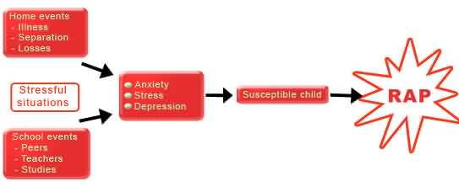
Psychological disturbances including over-reaction to normal life events and family dysfunction have been considered important in the pathogenesis of the symptoms

Slide 54
Presentation of children with RAP
Peri-umbilical pain is the most common location, but non specific pain is also typical
pain interrupts normal activity
there is usually no relationship with meals.
physical examination is normal between these episodes .

Slide 55
Differential Diagnosis
Wide range of potential organic causes of RAP must be considered before establishing a diagnosis of functional pain. Among the more common causes are :
Chronic Constipation,
Abdominal migraine,
Giardiasis
Peptic ulcer associated with H. pylori
Irritable bowel syndrome
Inflammatory bowel disease
Urinary tract infection

Slide 56
Symptoms suggestive of organic etiology (red flags on history and examination ) :
Age <6y , fever , loss of appetite , wt. loss or poor growth , joint symptoms
Pain away from umbilicus , and pain awakening the patient from sleep.
Vomiting , diarreoa and blood in stool , rash , Pallor
Abdominal tenderness, organomegally , occult blood in stool.

Slide 57
Red flags” on history “
Localized pain away from the umbilicus
Pain awakening the child at night
Pain associated with changes in bowel habits, dysuria, rash, arthritis
Occult bleeding
Repeated vomiting, especially bilious
Constitutional symptoms like recurrent fever, loss of appetite, lethargy

Slide 58
Red flags” on physical examination
Loss of weight or growth retardation
Organomegaly
Localized abdominal tenderness, particularly away from the umbilicus
Joint swelling, tenderness or heat
Pallor, rash

Slide 59
Evaluation
A careful history and examination
Routine urine testing and culture is mandatory
Stool for ova, cysts and parasites
CBC and ESR may be helpful in excluding anemia and inflammatory conditions
A plain abdominal film (calcification and gross constipation)
An abdominal ultrasound, particularly if urinary symptoms are suspected .

Slide 60
H. pylori test is indicated If symptoms suggestive of peptic ulcer .
Upper GIT endoscopy is indicated if persistent upper GIT pathology is suspected.

Slide 61
Management of RAP
Explain and reassure the child and family members
Identify red flags
Allow normal activity
Establish regular follow-up
Medications are generally unhelpful . Gastric acid blockers or anticholinergics can be tried empirically

Slide 62
Prognosis
A substantial proportion of children may continue to suffer in adult life from the symptoms of irritable bowel syndrome.
Children who develop symptoms at an early age and in whom treatment is delayed, the prognosis may be worse.

Slide 63
An 11-year-old girl has experienced periumbilical abdominal pain for 4 months. The pain occurs several times each week, it is variable in severity, She often has difficulty falling asleep at night .And When episodes occur at school, the school nurse usually calls the parents to take her home. She has missed 10 days of school during the last 2 month because of the pain. Her physical examinations is unremarkable .
Q1/ what is the most likely diagnosis?
Q2/ which of the following is essential for confirming the diagnosis?
barium meal
Laboratory study is unnecessary in this patient
upper gastrointestinal endoscopy is necessary
colonoscopy and biopsy is necessary
barium follow through

Slide 64
Q 3/ list the treatment plan to this patient?
Answer:
1/ recurrent abdominal pain / functional abdominal pain
2/ b
3/
reassurance of the child and family members
close follow-up
- Identify red flags
- Medications are generally unhelpful. Gastric acid blockers or anticholinergics can be tried empirically

Slide 65
References
M. Kyle Jensen and William F. Balistreri .Viral Hepatitis : Nelson Textbook of peditrics. Kliegman , Stanton , Schor . 20th Edition . John F. Kennedy , Philadelphia , Elsevier, 2016 : 2289 .
www.medescape.com ,Viral Hepatitis by Adrienne M Buggs, MD, Dec 16, 2014

Slide 66
Thank you

Slide 67
Thank you

Slide 79
Quiz 1
An 11-year-old male presented with a 10-day history of anorexia, nausea, upper abdominal discomfort and low grade fever .His urine was much darker than normal. On examination: afebrile but jaundiced , his liver palpable 4cm bcm and tender. The mother state that his young sister has had same complaint few weeks ago .
Q1 / What is the likely diagnosis?
Q2 / Name one confirmatory test to your diagnosis?
Quiz 2
A –newborn-baby delivered to a mother who state that she has hepatitis B infection during pregnancy .
Q1/ What immediate test you should do for the mother after labor ?
Q2 / If the mother`s test is positive name the treatment that should be given to the newborn ?

Slide 80
Pathogenesis
The acute liver injury is caused by 2 mechanisms , cytopathic and immune-mediated injury. The entire liver is involved.
With recovery, the liver morphology returns to normal within 3 mo of the acute infection.
If chronic hepatitis develops often leads to progressive scarring.

Slide 88
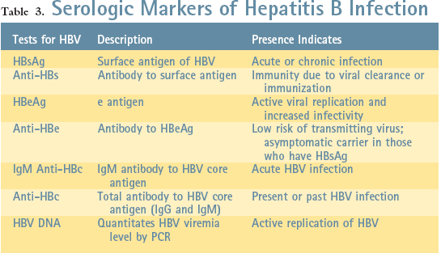
HBV Diagnosis

Slide 89
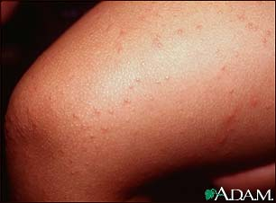
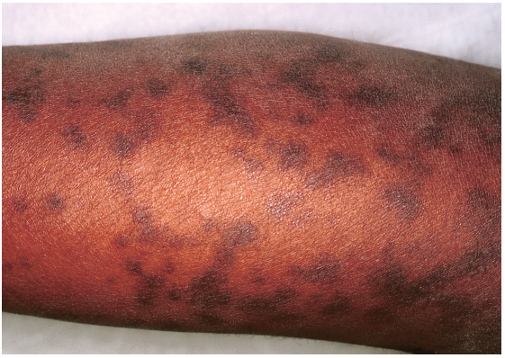
Gianotti-Crosti Syndrome( papular acrodermatitis )

Slide 90
Diagnosis
Routine screening for HBV infection requires assay of (HBsAg, anti-HBc, anti-HBs ).
HBsAg is the first serologic marker of infection to appear and is found in almost all infected persons state.
anti-HBc IgM rises early after the infection and remains positive for many months before being replaced by anti-HBc IgG, which then persists for years.
anti-HBs If Only is present mean person immunized with hepatitis B vaccine . when both anti-HBs and anti-HBc are detected mean persons with resolved infection.
HBeAg is present in active acute or chronic infection and is a marker of infectivity.
anti-HBe marks improvement and is a goal of therapy in chronically infected patients.
HBV DNA can be detected in the serum of acutely infected patients and chronic carriers.

Slide 91
Acute HBV infection : HBsAg +ve , Anti-HBc +ve , IgM anti-HBc +ve, Anti-HBs -ve
Chronic HBV infection : HBsAg +ve , Anti-HBc +ve , IgM anti-HBc -ve,Anti-HBs –ve
Immunity due to natural infection : HBsAg –ve , Anti-HBc +ve , Anti-HBs +ve
Immunity due to HBV vaccination : HBsAg –ve , Anti-HBc -ve , Anti-HBs +ve

Slide 92
Learning Objectives
Recognize the hepatotropic virus that cause viral hepatitis
To understand the mode of transmission and which children in the community at high risk of viral hepatitis
Identify the symptoms and sign and be familiar with the important diagnostic test required to diagnose viral hepatitis
Know how to deal with a child diagnosed as a case of viral hepatitis and recognize the complications and the outcome
control the disease in the community using preventive measures of transmission

Slide 93
A 6-years-old girl known to have transfusion dependent hemolytic anemia presented with fever , arthralgia and red color skin rash for few days then her mother states that she has malaise ,poor activity , dark color urine and anorexia .
On examination she looks tired , jaundiced , not dyspnic . BPr 90/60mmHg , PR 100b/min , RR 20 Cycle/min , temp 38 C . Normal chest and heart examination . Abdominal examination revealed palpable tender liver 5cm and palpable spleen 3cm .
Q1/ Give the most likely diagnosis
Q2 / What are the confirmatory test required ?
Q3 / What is the usual outcome ?
Q4 / Give 2 main complication of her disease .

Slide 94
After 7 month the same patient in the previous question during follow up visit , you find HBsAg positive .
Q1 / what is the diagnosis ?
Q2 / what other test would you suggest for her ?
Q3 / how would you treat this patient ?
Q4 / list the complication of this condition ?

Slide 95
A 17-years-old male presents with low grade fever for few days then generalize malaise , anorexia , vomiting , abdominal pain for 5 days duration . He noticed that his urine become deep color and the stool is faint color . On examination He is jaundiced ,looks mildly ill , not anemic not cyanotic , there is tender palpable liver 3-4cm bcm and there is a needle punctures marks on the left forearm most likely a marks of illegal drug injections .
Q1 / what is the likely diagnosis ?
Q2 / what important test would you recommend to confirm the diagnosis?
Q3 / what specific treatment required for this pateint?
Q4 / what is the prognosis and the possible complication of this disease?

